Slide 1
Make Jesus Real
M. Hancock

Slide 2
Summer Waters, aged 11 years
I saw Jesus last week.
He was wearing blue jeans and an old shirt.
He was up at the church building.
He was alone and working hard.
For just a minute, he looked a little like one of our members

Slide 3
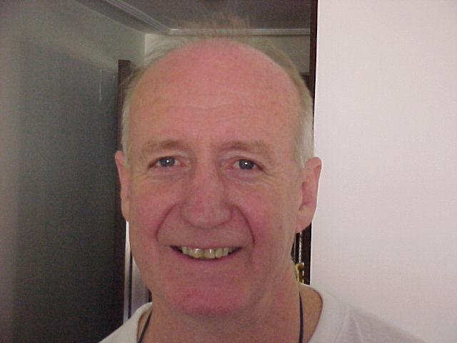
But it was Jesus – I could tell by his smile.

Slide 4
I saw Jesus yesterday.
He was at the hospital visiting a friend who was sick.
They prayed together quietly.
For just a minute he looked like Brother Jones.

Slide 5
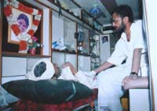
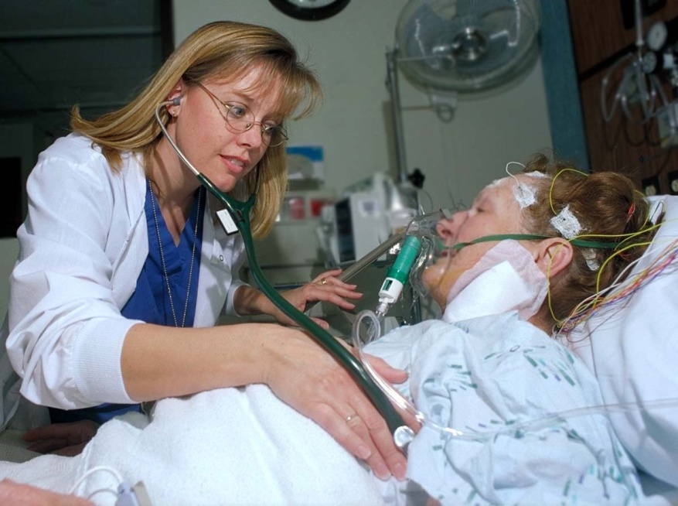
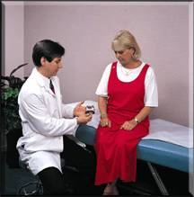
But it was Jesus – I could tell by the tears in his eyes.

Slide 6
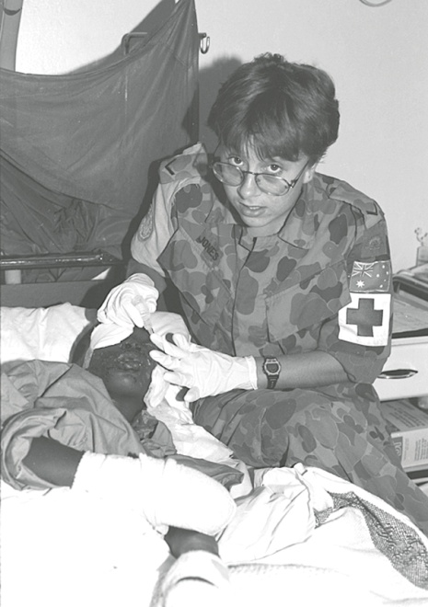
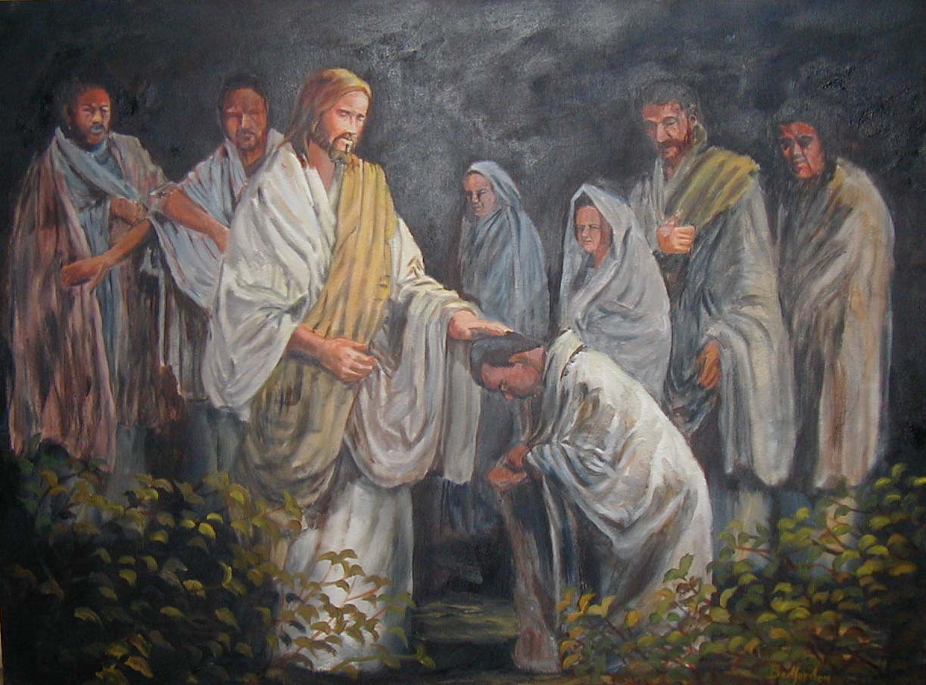
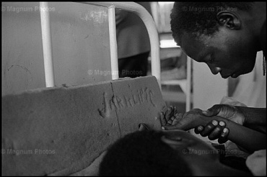
But it was Jesus – I could tell by the tears in his eyes.

Slide 7
I saw Jesus this morning.
He was in my kitchen making my breakfast and fixing me a special lunch.
For just a minute he looked like my mum.

Slide 8
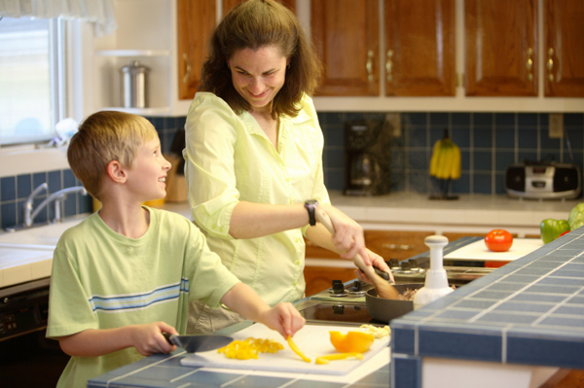
But it was Jesus – I could feel the love from his heart.

Slide 9
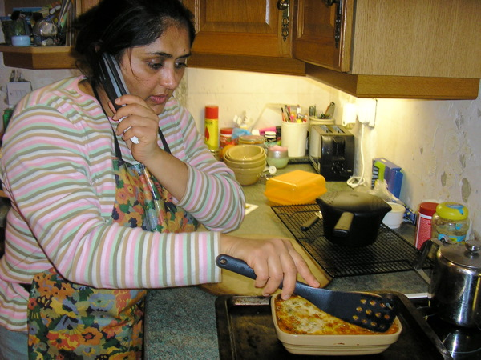
But it was Jesus – I could feel the love from his heart.

Slide 10
I see Jesus everywhere,
taking food to the sick,
welcoming others to his home,
being friendly to a newcomer,
and for just a minute,
I think he’s someone I know.

Slide 11
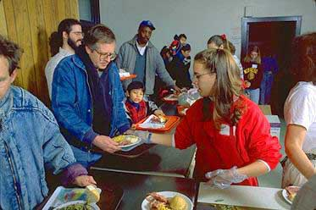
But it’s always Jesus – I can tell by the way he serves.

Slide 12
Can you see Jesus
in the people around you?

Slide 13
“I am the vine, and you are the branches. If you stay joined to me, and I stay joined to you, then you will produce lots of fruit. But you can’t do anything without me.”
John 15:5

Slide 14
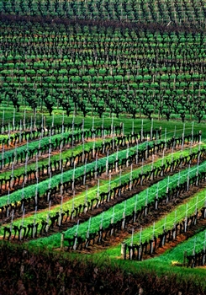

Slide 15
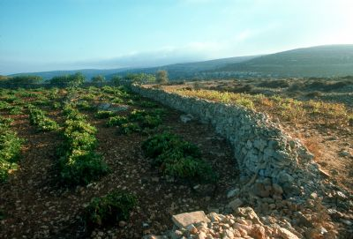
In your baptism, you were joined or grafted to Jesus, who is the vine.

Slide 16
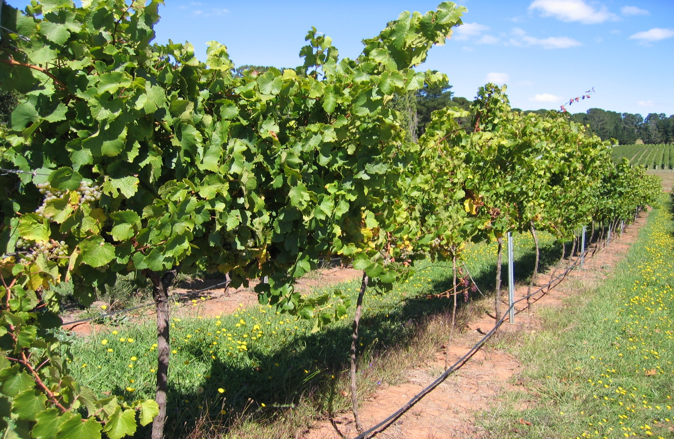
You have grown as a branch fed by the life-giving power of your Lord.

Slide 17
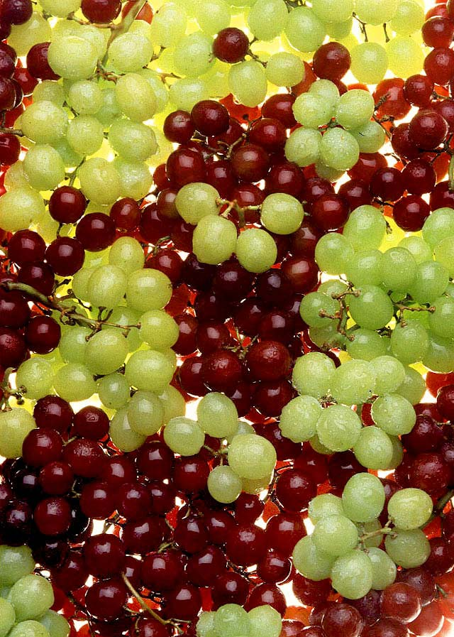
The secret is to stay connected to Jesus, so that you receive his power as you read God’s Word, and come to the Lord’s supper.

Slide 18
Then you will produce lots of beautiful fruit.

Slide 19
I am the vine, you are the branches ...
STAY CONNECTED TO JESUS

Slide 20
Let us pray
Lord Jesus, make me aware of what a privilege it is, to be able to bear good fruit for you in my life.
Help me always to stay connected to you, because I can’t do anything that pleases God without you.
We ask this in Your Name,
Amen.

