Slide 1
Spirit of Jesus
St. Cuthbert’s Catholic School

Slide 2
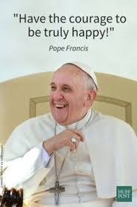
A Teacher’s impact - Powerful and long lasting
https://www.youtube.com/watch?v=eKToIrezxPw
Pope Francis - talks of an African Proverb
“It takes a Village to raise a child”
This supports a collaborative approach to :
Teachers, staff and families supporting each other in “The Spirit of Jesus”

Slide 3
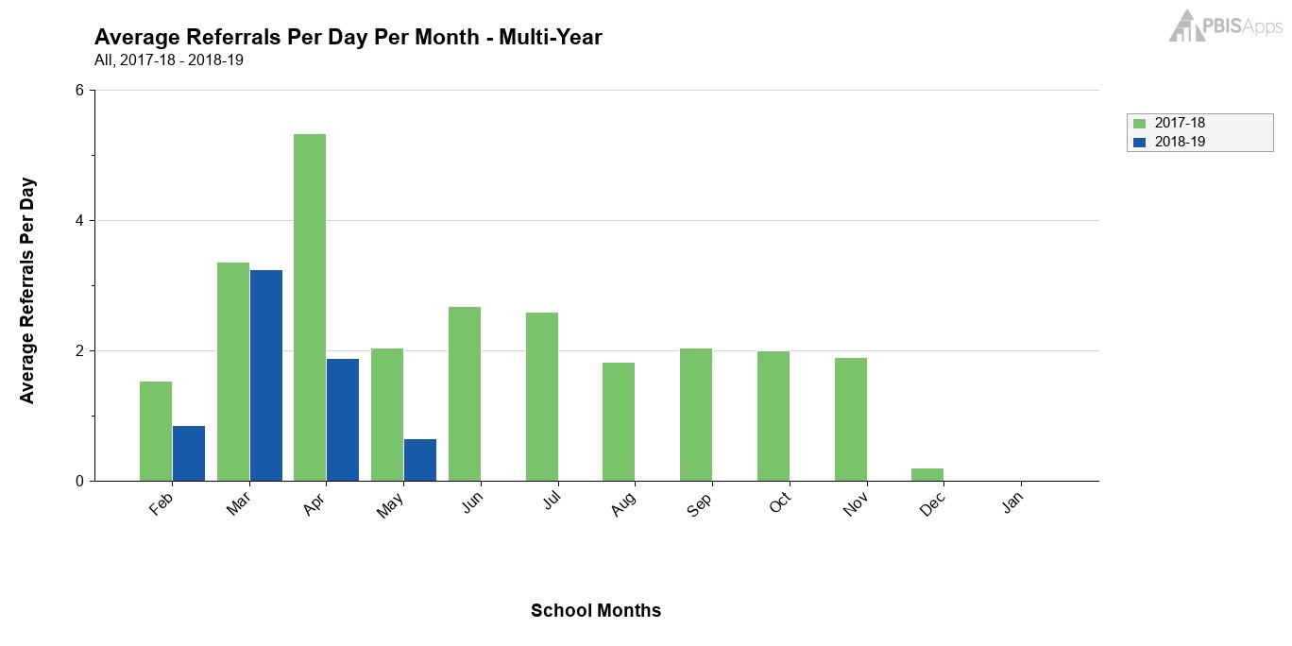
With Spirit of Jesus beginning to be embedded into life at
St. Cuthbert’s we have observed a drop in
behaviour referrals from the same period last year.

Slide 4
Spirit of Jesus
St. Cuthbert’s Catholic School
All classes use MJR which is helping develop consistent language across the school:
Grade 5/6 MJR - all students
3/4 Spirit of Jesus - all students
K-2 My Friend Jesus - Teacher copies at this point
To begin our School year classes discussed the meaning of SOJ and have developed prominent displays.
The Spirit of Jesus is with us. To build class Spirit, children are encouraged to be aware and to “Get Switched ON” to HIS presence in our lives.
Children share SOJ moments and name it up for display.

Slide 5
Spirit of Jesus
St. Cuthbert’s Catholic School
Classes timetable “Circle Time” into our weekly programs
MJR & SOJ is incorporated into these sessions with a weekly focus
As part of PBS (Positive Behaviour Support), we incorporate MJR and SOJ into our Social and Emotional Learning programs
Additional Circle Time given for our Tier 2 students requiring a little additional support once a week as Small Circle time

Slide 6
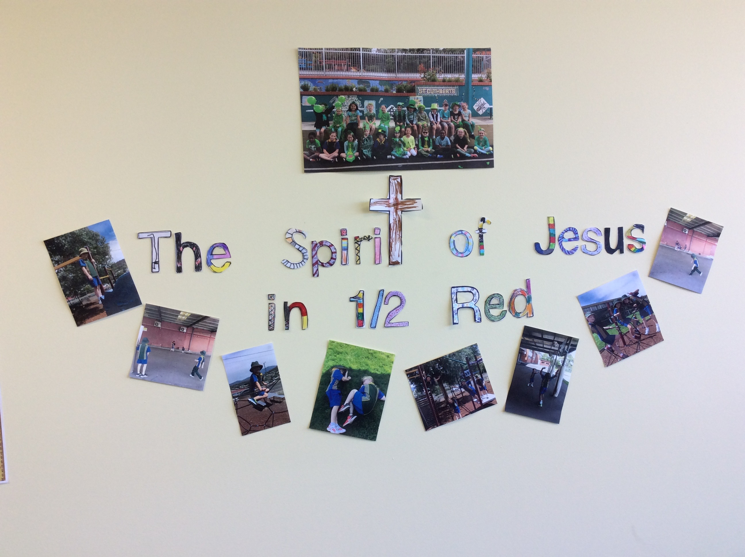
Spirit of Jesus
Class Displays in each Unit at St. Cuthbert’s

Slide 7
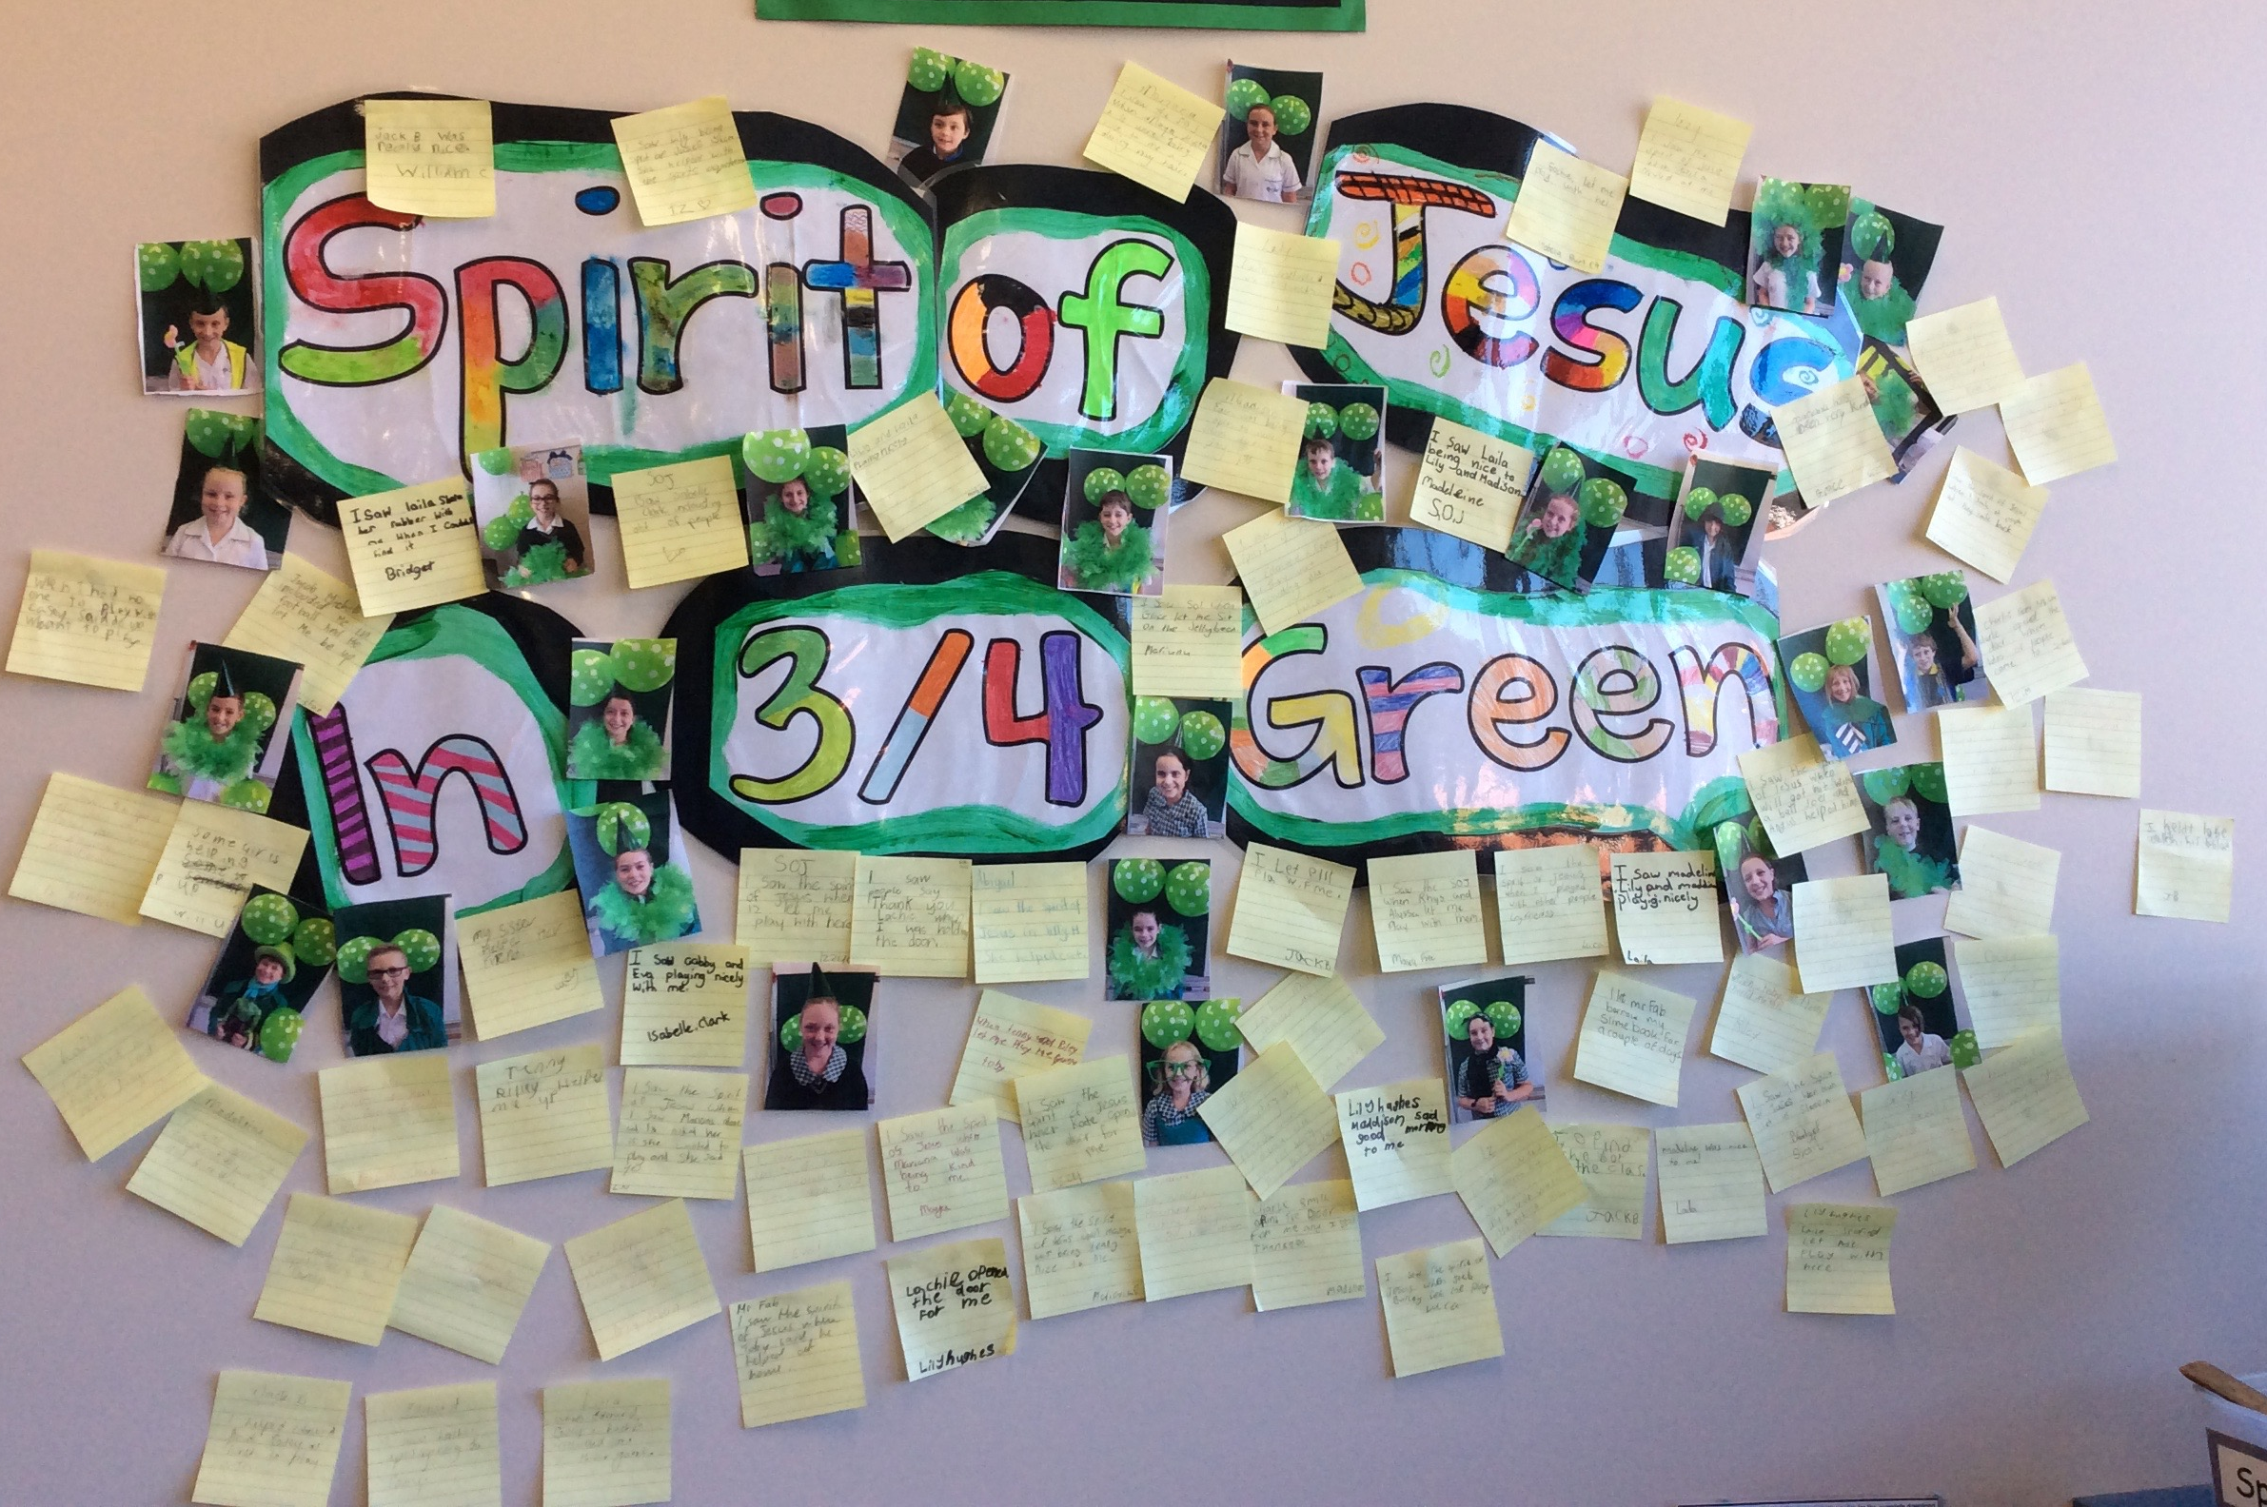
Spirit of Jesus
Class Displays in each Unit at St. Cuthbert’s

Slide 8
Going to your Heart Room
Your Heart room is a special place where you can be at peace with Jesus.
We have quiet reflection time across the school to hear what HE wants to say to us. Close your eyes and concentrate on your breathing - feel your body relaxing.
K-2 class journal involves discussion mainly, Grades 3-6 written journal entries.
Picture yourself sitting quietly with Jesus in your Heart Room Let HIM speak to you.

Slide 9
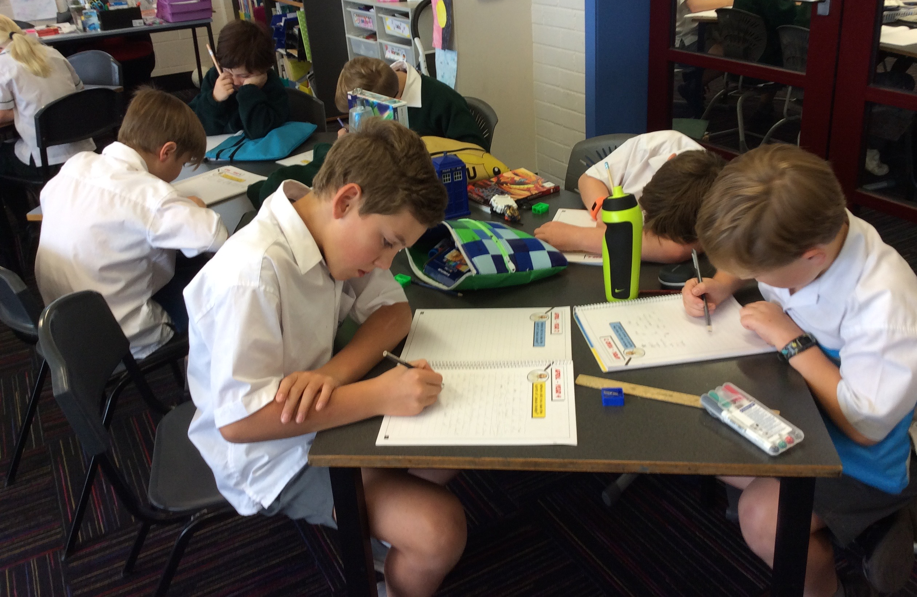
Spirit of Jesus
Go to your Heart Room
Journalling - 2-3 times per week

Slide 10
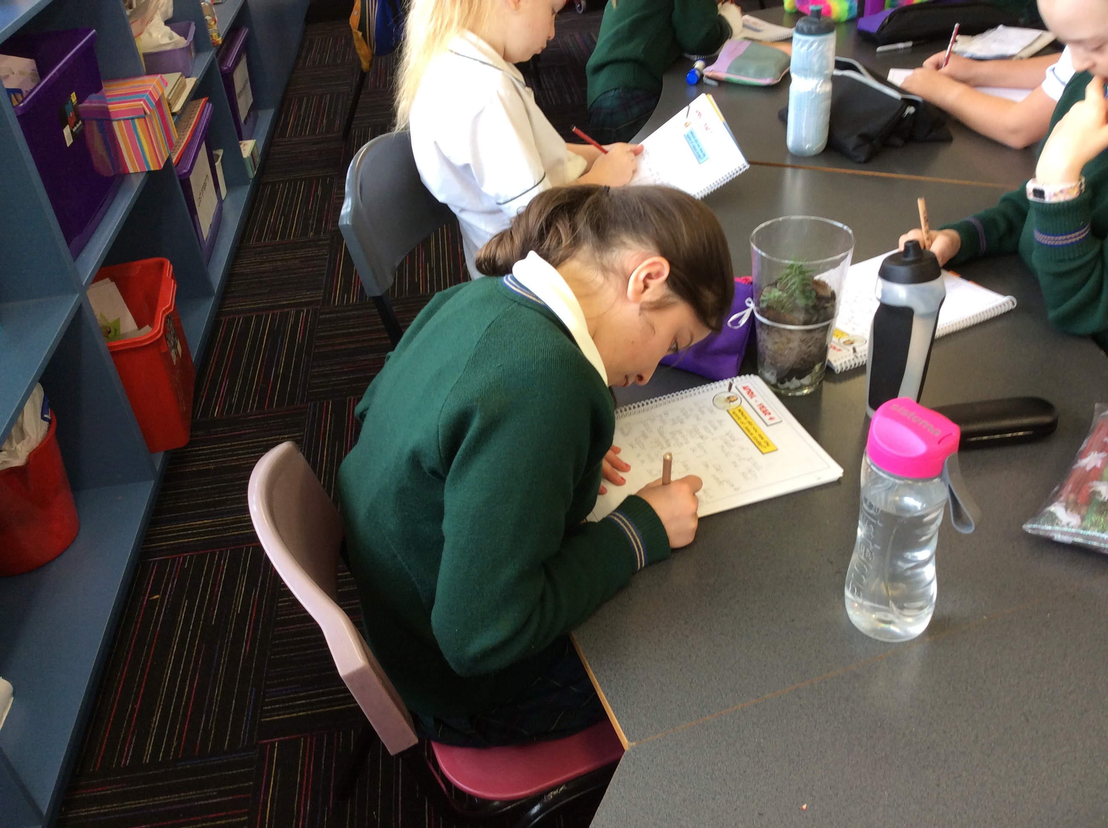
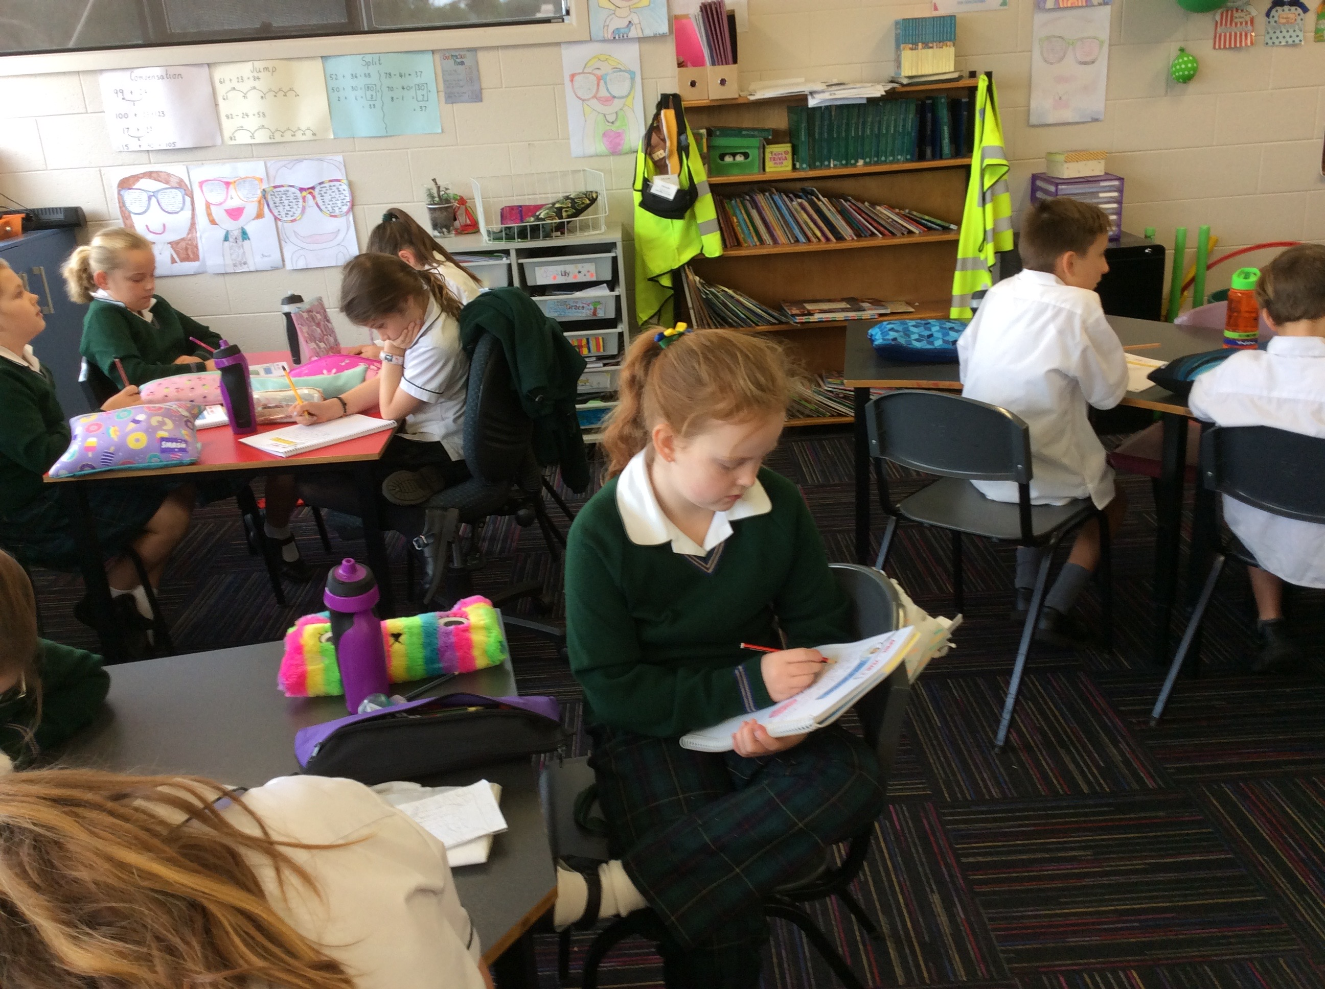
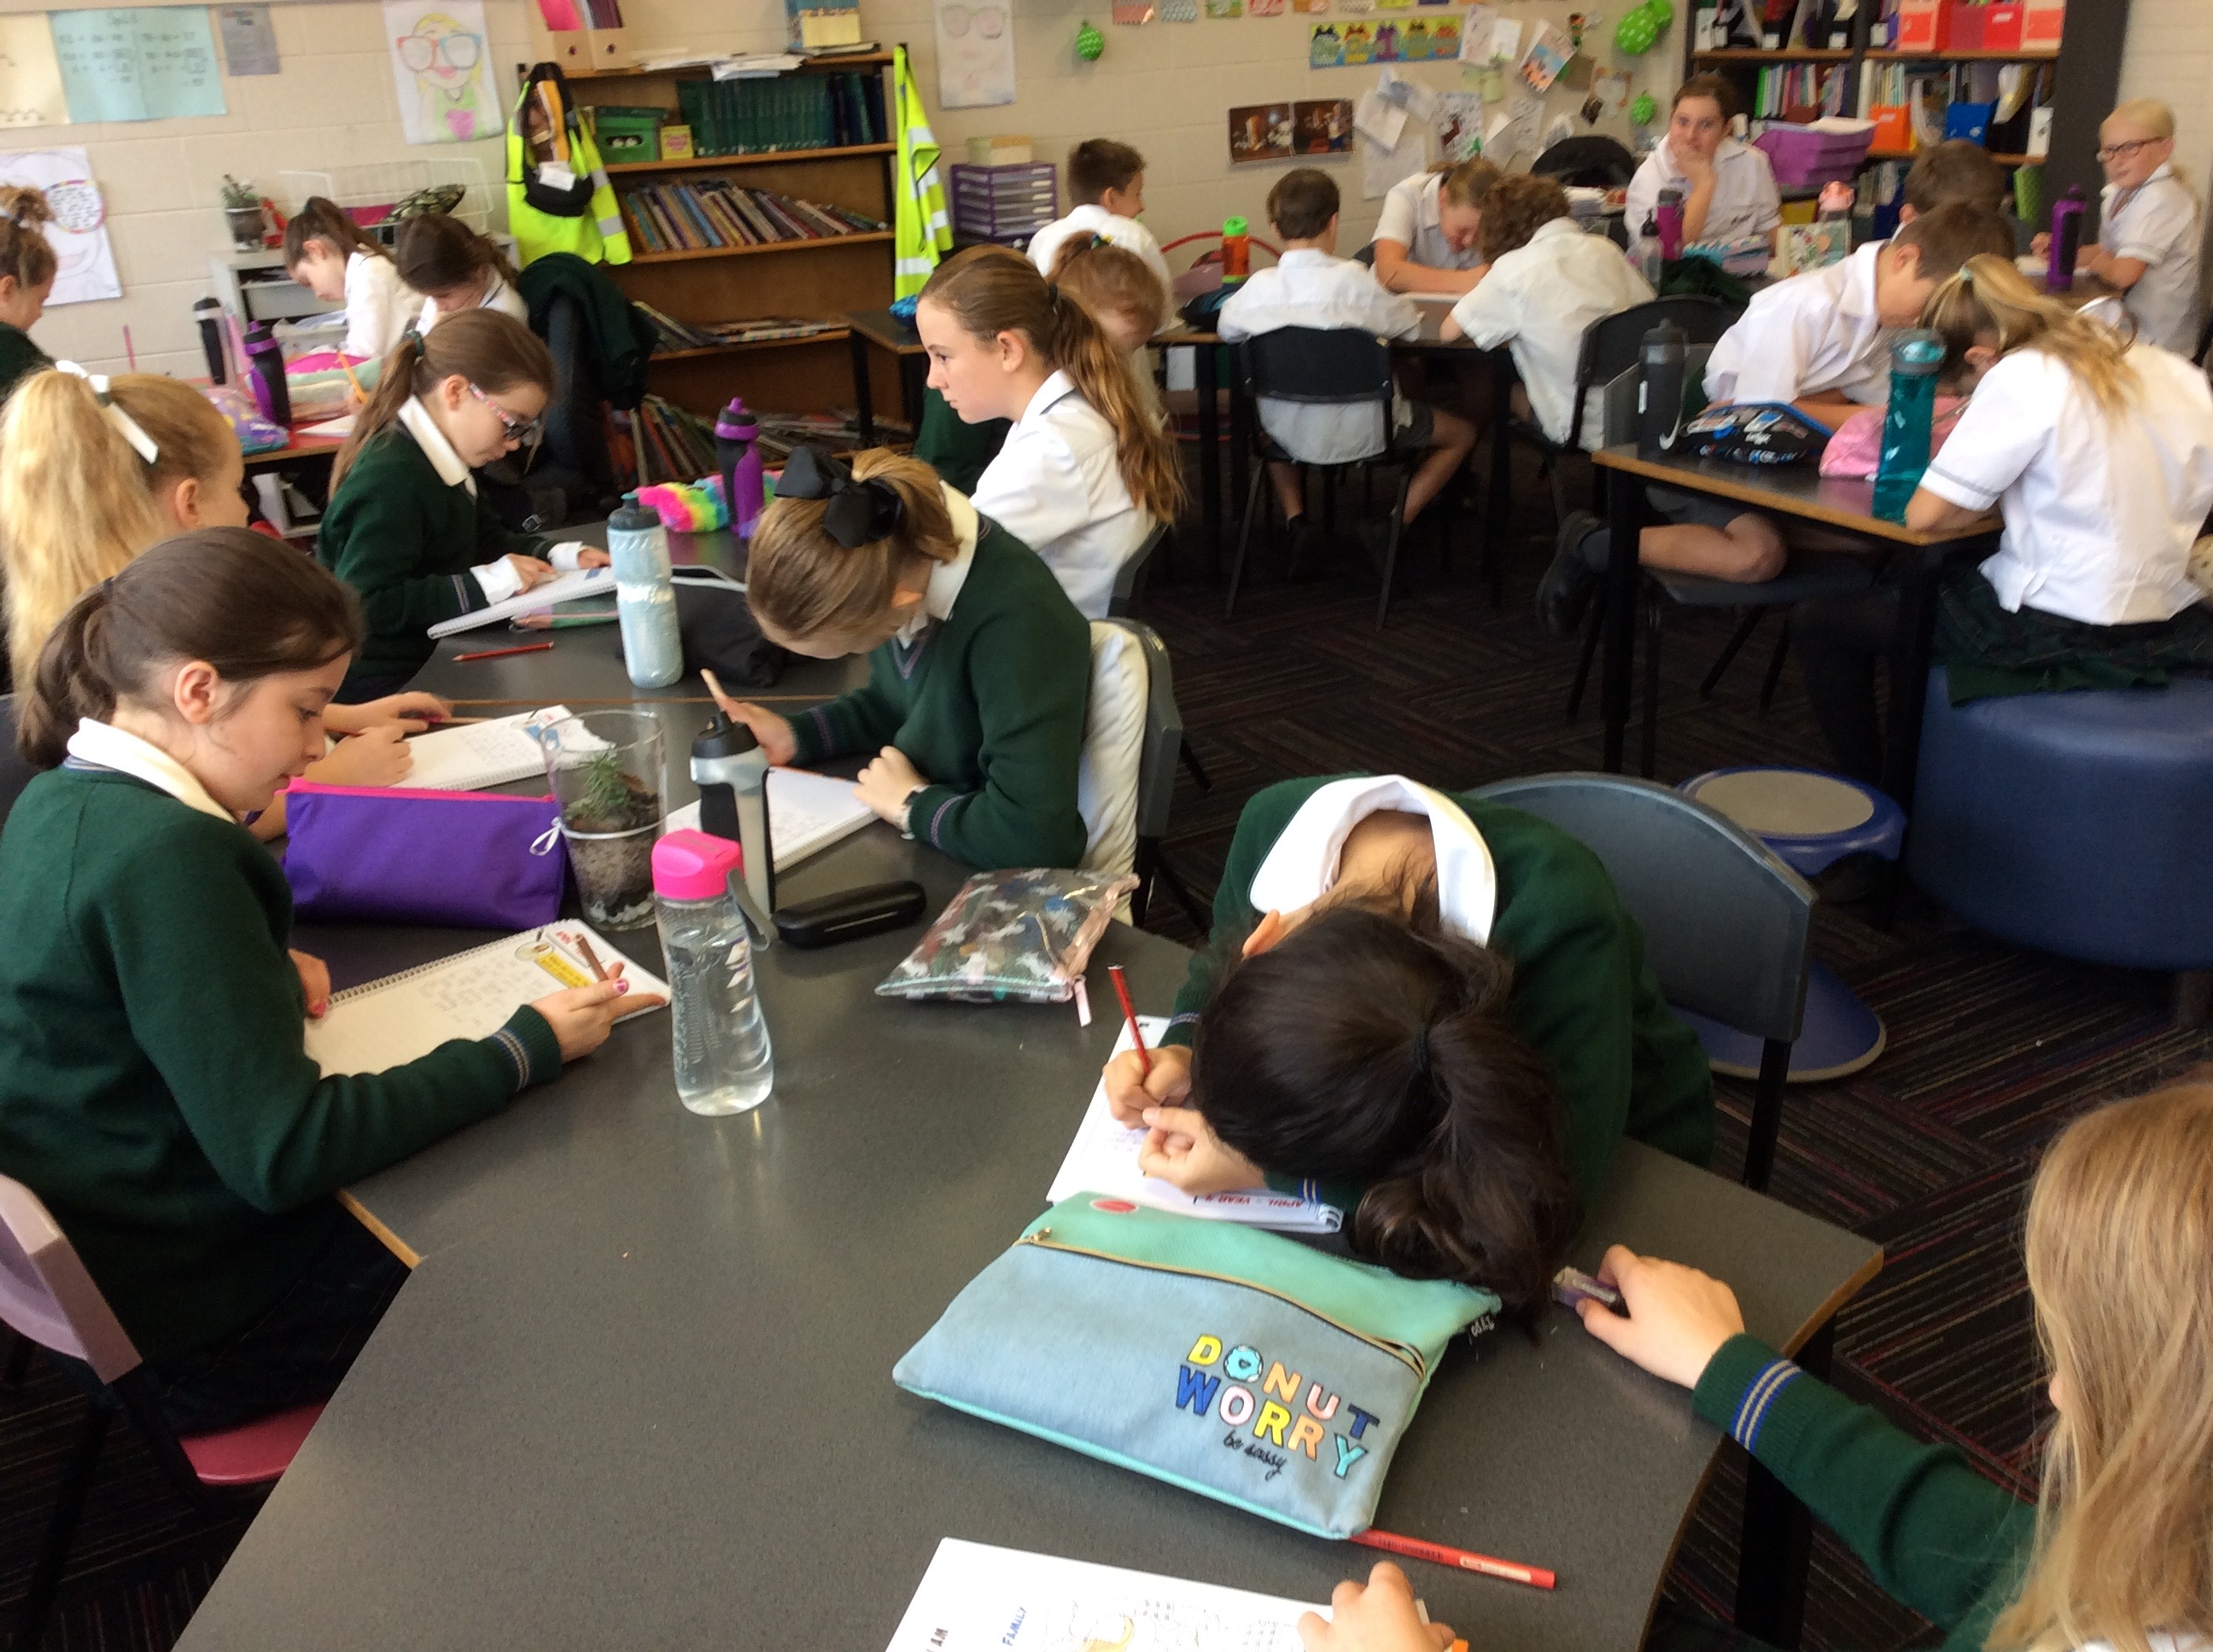
Spirit of Jesus
Go to your Heart Room
Journalling - 2-3 times per week

Slide 11
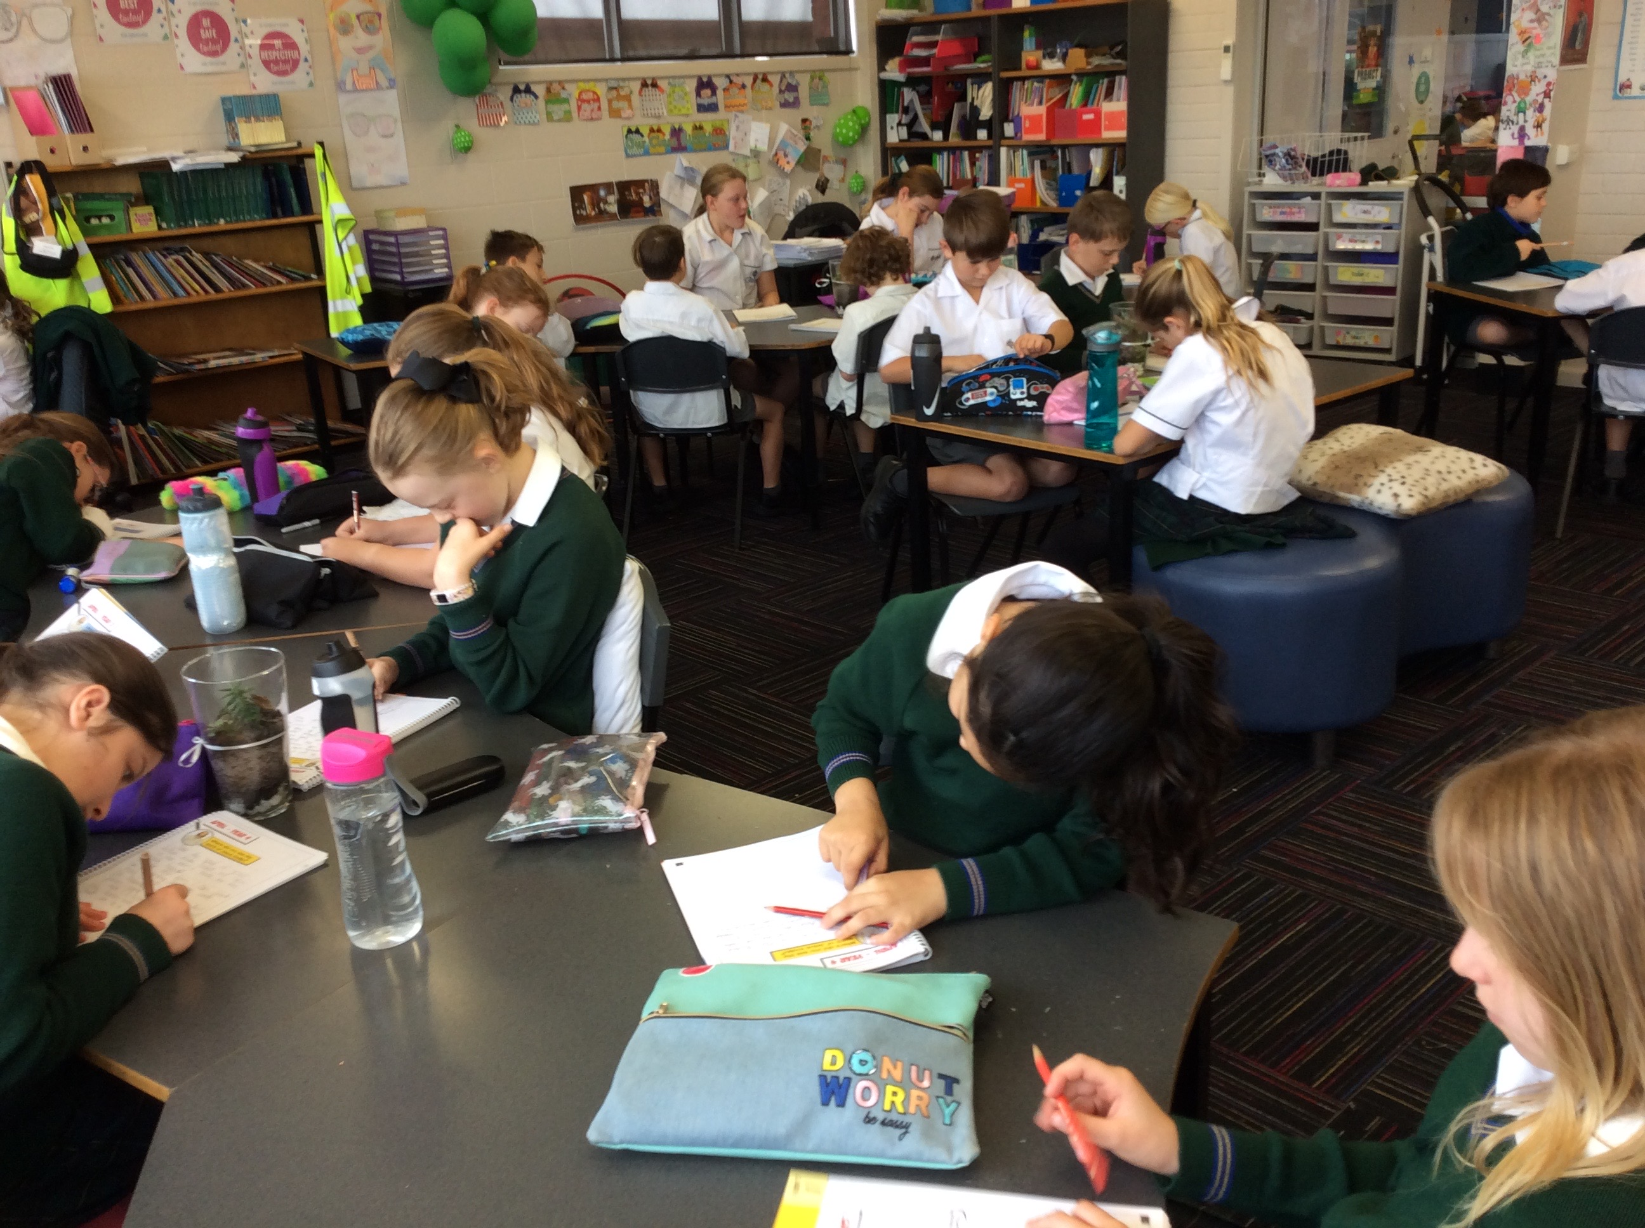
Spirit of Jesus
Go to your Heart Room
Journalling - 2-3 times per week

Slide 12
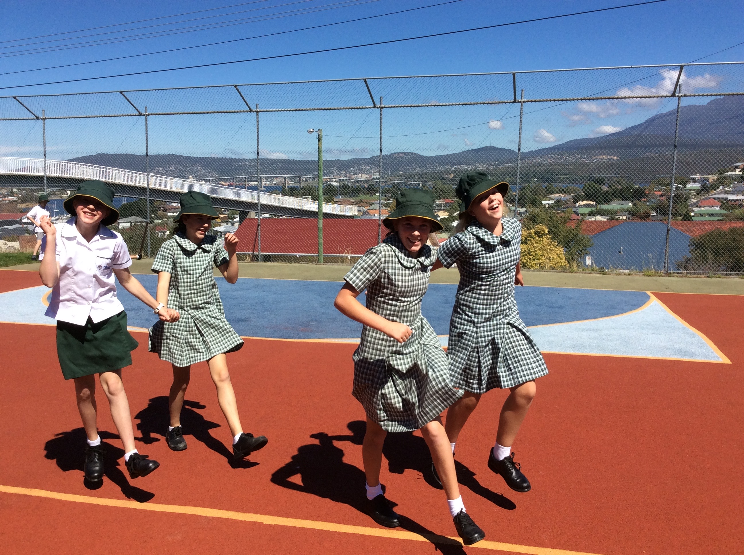
Spirit of Jesus
Live it and name it up - “Get switched on”
It’s happening everyday and all around us - Celebrate the “Good News”

